Slide 1

DriverPass System Analysis
Nevena Young
Notes:
[No speaker notes required for this slide.]

Slide 2

System Requirements
Functional Requirements
Choose Package
Cancel or change a Package
Non-Functional Requirements
Updated Security
Updated Info from the DMV
Notes:
Two functional requirements are the ability to choose packages, and the client being able to disable packages.
Two non-functional requirements are having updated software to handle any bugs or breaches, as well as, updated information on the DMV.
Theses meet the requirements of DriverPass because it gives the user the chance to view the available packages and purchase one. Also, gives the user up to date information from the DMV… In case a driving rule change or gets added.

Slide 3
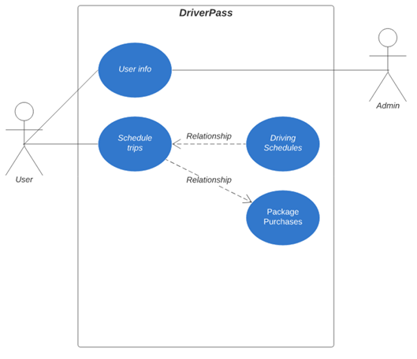
Use Case Diagram
Notes:
The different actors in the system are the admin, the user, and the instructor.
The different use cases are user info, schedule trips, driving schedules, and package purchase.
These meet the requirements of DriverPass by having a way for the user to log in and maintain their account and purchases.

Slide 4
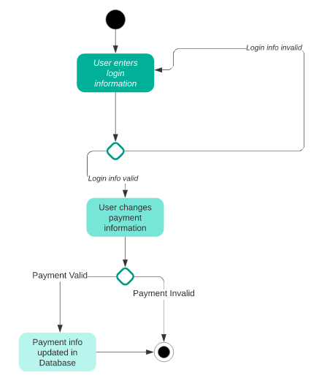
Activity Diagram
Notes:
The case I am breaking down is when a user logs in to edit their payment information.
The steps are;
Login
If login info valid, continue
Select payment info to update
If payment is valid, continue.
The process is complete
This accounts to what is needed for DriverPass due to the process of logging in and making changes to user’s account.

Slide 5
Security
Web-based system that updates regularly
Whoever logs in needs a username and password in order to gain access
The admin will be notified of hacking attempts, failed attempts for logins, and any other movements within the system
If a user forgets their password, they can follow the instructions to reset their password
Notes:
I though of the main priority, and it was keeping information secure. If a user knows their information is secure and regularly updated, it’ll put them at ease and more willing to entrust us with their sensitive information.

Slide 6
System Limitations
System requires a stable internet connection.
The client sets the budget
Exams are based on the DMV guidelines
Notes:
Without a secure stabled internet connection, the user will not be able to log into their account.
When the client sets the budget, the team must work within the budget and complete the project. This could cause some issues if there are requirements that cause the budget to be over the set price.
The exams are based on the DMV and might not meet the requirements for all. Even though this is the DMV requirements, the user could get upset at us.

